Slide 1
Collin County Intermodal Study
Update to Collin County Commissioners Court
Kyler Erhard &
Sandy Wesch, PE, AICP
March 29, 2010

Slide 2
Study Overview
Study requested by Collin County
First meeting in October 2009
Joint effort by Collin County, NETEX, and NCTCOG
The purpose of the study is to determine whether or not there is a need for a third intermodal/logistics hub within Collin County, timing, location, and physical and operational requirements

Slide 3
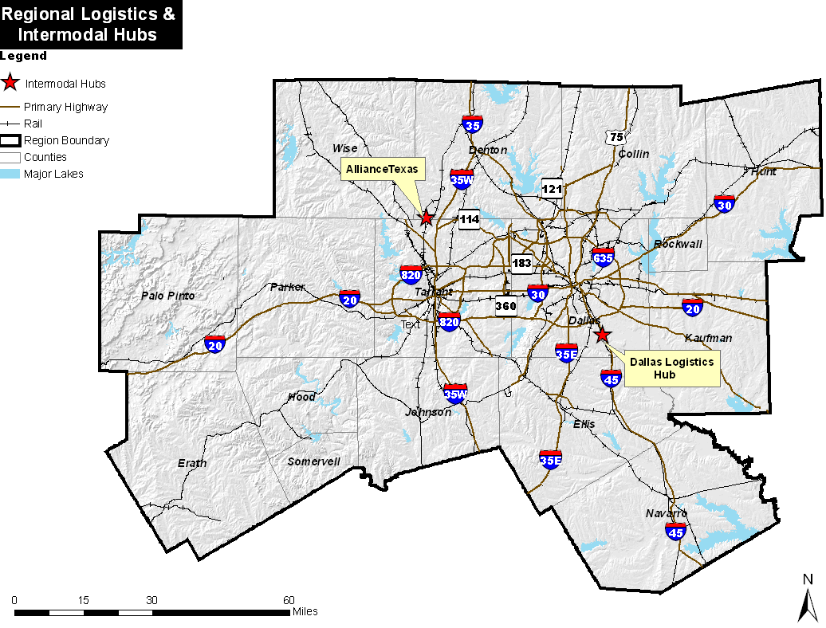
Background
There are currently two intermodal/logistics hubs in the region: AllianceTexas and Dallas Logistics Hub
Both of these logistics hubs are served by both freight rail and trucks

Slide 4
Freight Movement Statistics for the Dallas-Fort Worth Region
9th highest export value of any US metropolitan area
Home to the largest foreign trade zone in terms of value of foreign imports
5th highest GDP of all metropolitan areas
One of the largest inland ports in the nation
19th out of 50 US ports in value of total shipments

Slide 5
Study Phases
Phase 1 – Feasibility Study
  Estimate the market/need for a 3rd intermodal
  Identify potential locations
  Evaluate physical and operational issues
Phase 2 – Implementation Study
  Development of Institutional and Organizational Implementation Plan
  Assess Costs, Benefits, and Revenues
  Develop Financial Plan
  Develop Draft RFP to Investment Community and Regional Rail Operators

Slide 6
Establishment of Study Areas
Key criteria for selection
  Access to a Class I railroad
  Access to a major roadway facility
  Availability of land
Study areas have a three-mile radius
Five potential locations identified
  Site #1: Celina
  Site #2: Melissa
  Site #3: Farmersville
  Site #4: Southeast Collin County
  Site #5: Collin County Regional Airport, McKinney

Slide 7
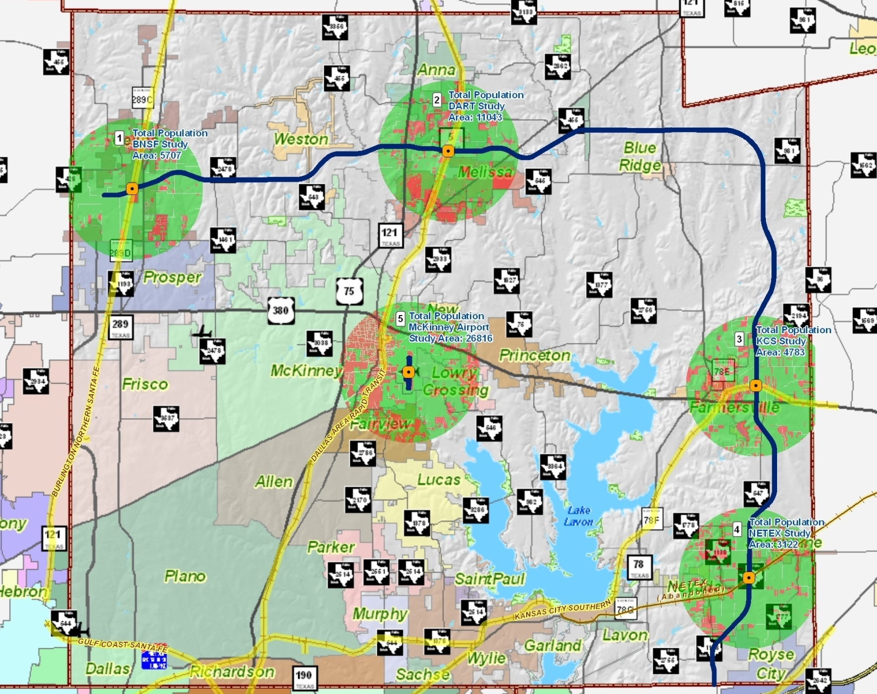
Potential Sites to be Studied
7

Slide 8
Next Steps
Develop evaluation criteria
Continue data collection
Evaluate potential locations
Make recommendation
Develop final report
Estimated completion date:
September 2010 for Phase 1

